Slide 1
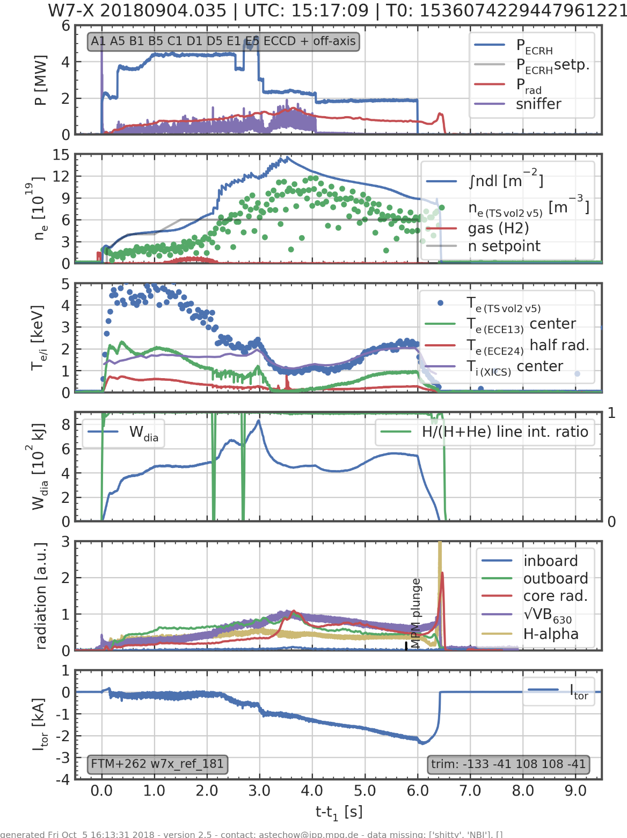
Stabilize high Ti-mode by reduction of ECRH power
Density peaking
Te=Ti for 3s!
high tripple product
2.2*1* 0.3=0.66

